Slide 1
2 Pass Assemblers CS 348 Implementation of Programming Languages Lab Department of CSE IIT Guwahati

Slide 2
High Level Programming Languages
Python / C ++
print("Hello World")
Low Level Assembly Language
(Device Drivers / Embedded Systems / Real-time systems
e.g. STR 5
Interpreter / Compiler
Assembler
Executable Machine Code
Executable by the CPU / Different for every machine
0100 01101001

Slide 3
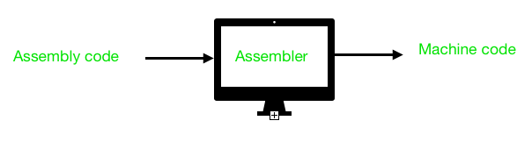
Introduction
Assembler is a program for converting instructions written in low-level assembly code into relocatable object code and generating information for the loader.
It generates machine-level instructions by evaluating the mnemonics (symbols) in the operation field and finds the value of symbols and literals to produce object code.

Slide 4
Assembler Directives
Assembler Directives are Pseudo-Instructions. They are not translated into machine instructions. They provide instructions to the assembler.
Basic assembler directives:
START
END
BYTE
WORD
RESB
RESW

Slide 5
Symbols, Literals, Opcodes and Operands
Symbols: A symbol is a single character or combination of characters used as a label or operand.
-Symbols may consist of numeric digits, underscores, periods, uppercase or lowercase letters, or any combination of these.
-The symbol cannot contain any blanks or special characters, and cannot begin with a digit. Uppercase and lowercase letters are distinct.
Literals: Constants. Assembly language source code can contain numeric, string, Boolean, and single character literals.
Opcodes and Operands: The opcode is the instruction that is executed by the CPU and the operand is the data or memory location used to execute that instruction.

Slide 6
2 Pass Assembler Process
Symbol Table
Variables / Labels
Literal Table
Constants
Assembly Code
Pass 1
Analysis
Pass 2
Synthesis
Object Code
Linker
Executable
Machine Code
At Run Time
Opcode Table
opcode → binary
Executable
Loader

Slide 7
Pass 1 – Analysis Phase
This part scans the program looking for symbols, labels, variables, etc, and organises them in tables
Passes through the instructions in sequence, looking for symbol addresses
Create a symbol and literal table
Keep track of the location counter
Process Pseudo operations (macros / directives)
Error Checking
Tokenization: Read the input one ASCII char at a time; i.e. as a stream of char. The first step is to group characters into meaningful tokens.
Macros
Names, subroutines can can be used more than once. Designed to make programming easier and more module
Directives
Configuration instructions for assembler (such as memory allocation)
Not a program instruction itself.

Slide 8
 | ORG | #100
BeginProg | LDV | #countUp
 | OUTCH
 | CMP | NumA
 | JMP | Finish
 | JNE | MoveOn
MoveOn | LDD | countUp
 | INC
 | STO | countUp
 | JMP | BeginProg
Finish | LDM | #25
 | END
countUp |  | 200
 |  | 21
 |  | 35
NumA |  | 20
Labels
The programmer uses these to refer to specific lines in the code rather than to refer to them by a line number.
This makes the program easier to read for humans, allowing the code to be broken down into sections.

Slide 9
 | ORG | #100
BeginProg | LDV | #countUp
 | OUTCH
 | CMP | NumA
 | JMP | Finish
 | JNE | MoveOn
MoveOn | LDD | countUp
 | INC
 | STO | countUp
 | JMP | BeginProg
Finish | LDM | #25
 | END
countUp |  | 200
 |  | 21
 |  | 35
NumA |  | 20
Labels
The programmer uses these to refer to specific lines in the code rather than to refer to them by a line number.
This makes the program easier to read for humans, allowing the code to be broken down into sections.

Slide 10
Pass 1 Analysis
walkthrough

Slide 11
 | ORG | #100
BeginProg: | LDV | #countUp
 | OUTCH
 | CMP | NumA
 | JMP | Finish
 | JNE | MoveOn
MoveOn: | LDD | countUp
 | INC
 | STO | countUp
 | JMP | BeginProg
Finish: | LDM | #25
 | END
countUp |  | 200
 |  | 21
 |  | 35
NumA |  | 20
Symbol Table

Slide 12
 | ORG | #100
BeginProg: | LDV | #countUp
 | OUTCH
 | CMP | NumA
 | JMP | Finish
 | JNE | MoveOn
MoveOn: | LDD | countUp
 | INC
 | STO | countUp
 | JMP | BeginProg
Finish: | LDM | #25
 | END
countUp |  | 200
 |  | 21
 |  | 35
NumA |  | 20
Symbol Table
BeginProg | 100

Slide 13
 | ORG | #100
BeginProg: | LDV | #countUp
 | OUTCH
 | CMP | NumA
 | JMP | Finish
 | JNE | MoveOn
MoveOn: | LDD | countUp
 | INC
 | STO | countUp
 | JMP | BeginProg
Finish: | LDM | #25
 | END
countUp |  | 200
 |  | 21
 |  | 35
NumA |  | 20
Symbol Table
BeginProg | 100
countUp

Slide 14
 | ORG | #100
BeginProg: | LDV | #countUp
 | OUTCH
 | CMP | NumA
 | JMP | Finish
 | JNE | MoveOn
MoveOn: | LDD | countUp
 | INC
 | STO | countUp
 | JMP | BeginProg
Finish: | LDM | #25
 | END
countUp |  | 200
 |  | 21
 |  | 35
NumA |  | 20
Symbol Table
BeginProg | 100
countUp
NumA

Slide 15
 | ORG | #100
BeginProg: | LDV | #countUp
 | OUTCH
 | CMP | NumA
 | JMP | Finish
 | JNE | MoveOn
MoveOn: | LDD | countUp
 | INC
 | STO | countUp
 | JMP | BeginProg
Finish: | LDM | #25
 | END
countUp |  | 200
 |  | 21
 |  | 35
NumA |  | 20
Symbol Table
BeginProg | 100
countUp
NumA
Finish

Slide 16
 | ORG | #100
BeginProg: | LDV | #countUp
 | OUTCH
 | CMP | NumA
 | JMP | Finish
 | JNE | MoveOn
MoveOn: | LDD | countUp
 | INC
 | STO | countUp
 | JMP | BeginProg
Finish: | LDM | #25
 | END
countUp |  | 200
 |  | 21
 |  | 35
NumA |  | 20
Symbol Table
BeginProg | 100
countUp
NumA
Finish
MoveOn

Slide 17
 | ORG | #100
BeginProg: | LDV | #countUp
 | OUTCH
 | CMP | NumA
 | JMP | Finish
 | JNE | MoveOn
MoveOn: | LDD | countUp
 | INC
 | STO | countUp
 | JMP | BeginProg
Finish: | LDM | #25
 | END
countUp |  | 200
 |  | 21
 |  | 35
NumA |  | 20
Symbol Table
BeginProg | 100
countUp
NumA
Finish
MoveOn | 105

Slide 18
 | ORG | #100
BeginProg: | LDV | #countUp
 | OUTCH
 | CMP | NumA
 | JMP | Finish
 | JNE | MoveOn
MoveOn: | LDD | countUp
 | INC
 | STO | countUp
 | JMP | BeginProg
Finish: | LDM | #25
 | END
countUp |  | 200
 |  | 21
 |  | 35
NumA |  | 20
Symbol Table
BeginProg | 100
countUp
NumA
Finish | 109
MoveOn | 105

Slide 19
 | ORG | #100
BeginProg: | LDV | #countUp
 | OUTCH
 | CMP | NumA
 | JMP | Finish
 | JNE | MoveOn
MoveOn: | LDD | countUp
 | INC
 | STO | countUp
 | JMP | BeginProg
Finish: | LDM | #25
 | END
countUp |  | 200
 |  | 21
 |  | 35
NumA |  | 20
Symbol Table
BeginProg | 100
countUp | 111
NumA
Finish | 109
MoveOn | 105

Slide 20
 | ORG | #100
BeginProg: | LDV | #countUp
 | OUTCH
 | CMP | NumA
 | JMP | Finish
 | JNE | MoveOn
MoveOn: | LDD | countUp
 | INC
 | STO | countUp
 | JMP | BeginProg
Finish: | LDM | #25
 | END
countUp |  | 200
 |  | 21
 |  | 35
NumA |  | 20
Symbol Table
BeginProg | 100
countUp | 111
NumA | 114
Finish | 109
MoveOn | 105

Slide 21
SYMTAB
Content: Label name, value, flag, (type, length) etc.
Characteristic: Dynamic table (insert, delete, search)
Implementation: Hash table
Symbol Table
BeginProg | 100
countUp | 111
NumA | 114
Finish | 109
MoveOn | 105

Slide 22
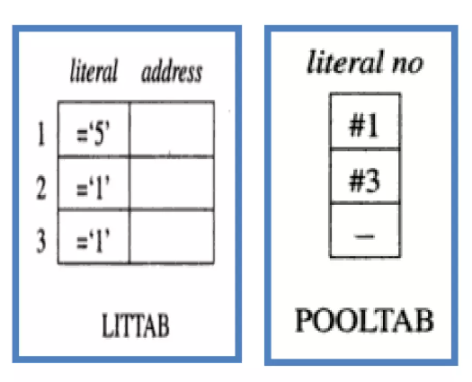
LITTAB
Contents: Literal name, the operand value, and length, the address assigned to the operand
How to build?
Build LITTAB with literal name, operand value, and length, leaving the address unassigned
When an LTORG statement is encountered, assign an address to each literal not yet assigned an address.

Slide 23

OPTAB
Content:
Mnemonic, machine code (instruction format, length) etc.
Characteristic:
Static Table
Implementation:
Array or hash table, easy for search

Slide 24
Possible Errors in Pass 1
Duplicate label
Invalid operand
Unrecognized entry in opcode field etc.

Slide 25
Pass 2 – Synthesis Phase
If no errors are found in pass one, then the second pass assembles the code into object code.
This process often includes the following:
Symbolic addresses are replaced with relative addresses
Symbolic opcodes are replaced with binary opcodes

Slide 26
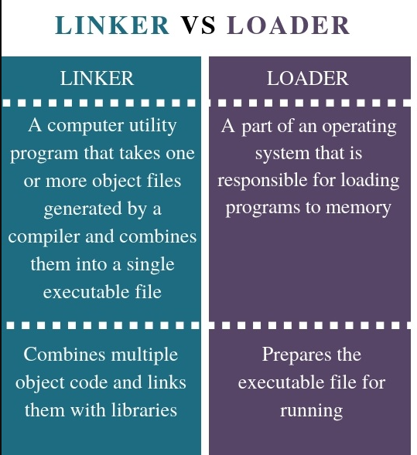
Linker vs Loader

Slide 27
2 Pass Assembler Process
Symbol Table
Variables / Labels
Literal Table
Constants
Assembly Code
Pass 1
Analysis
Pass 2
Synthesis
Object Code
Linker
Executable
Machine Code
At Run Time
Opcode Table
opcode → binary
Executable
Loader

Slide 28
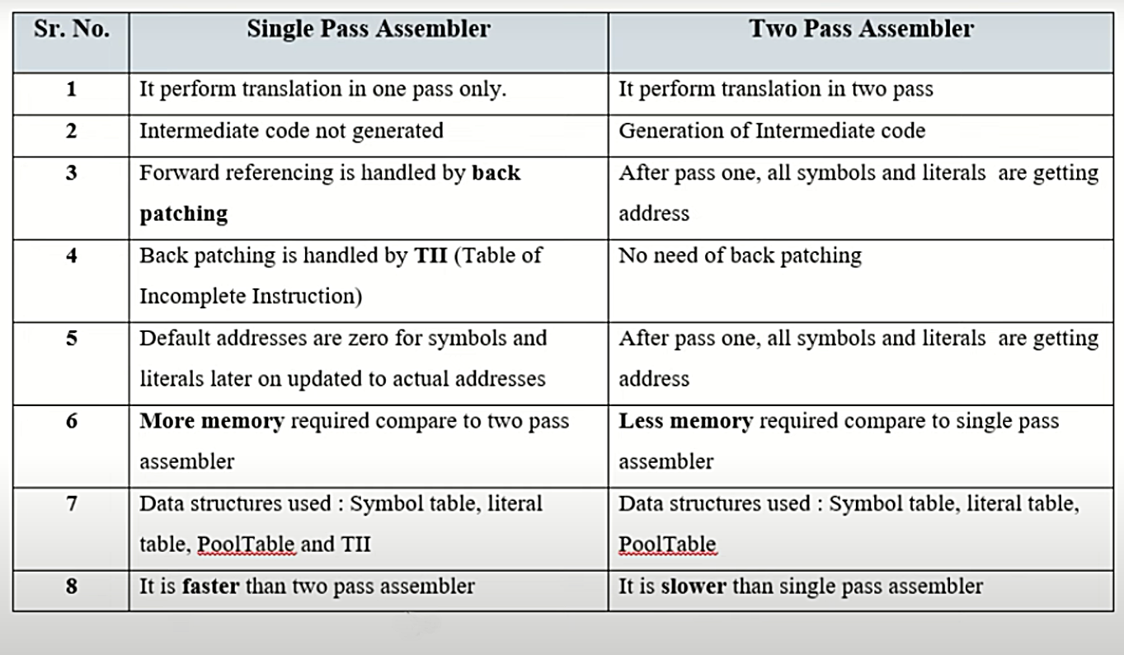
One Pass vs Two Pass Assembler

Slide 29
Thank you!

